Slide 1
Managerial Economics and Organizational Architecture Chapter 8:
Economics of Strategy: Creating and Capturing Value

Slide 2

Strategy
Note; se også kap. 11.
General policies intended to generate profits
Choice of industry
Combination of products and services
Competitive and cooperative behaviors
Strategies evolve as circumstances change
Strategies must create and capture value
Kilde: https://wmep.org/manufacturing-growth-solutions/strategy/
2

Slide 3

Transaction Costs
Consumer transaction costs
product search
learning product characteristics and quality
negotiating terms of sale
enforcing agreements
Producer transaction costs
negotiating terms
legal expenses
Kilde: https://world.org/learncenter/scroll-through-worldcoin-beginner-guides-to-learn-the/what-are-transaction-costs
3

Slide 4
Ways to Create Value reduction of transaction costs
Effective supply given
transaction costs
Consumer-borne transaction costs
Potential supply if no
Transaction costs
Consumer surplus
Price (in dollars)
Producer surplus
Producer-borne transaction costs
Potential demand if no
Transaction costs
Effective demand after
Transaction costs
Q
Quantity
4

Slide 5
Value Creation
Reduce production costs or producer transaction costs
shift supply curve to the right
Reduce consumer transaction costs
shift demand curve to the right
Shift demand to the right by other means
Devise new products and services
5

Slide 6
Pricing Complements Example Reduce the price of complements?
CompuInc produces computers
PrintCo produces complementary printers
Demand for each product is
‘2 l. med 2 ub.’! => P = Q = 4! Profit 1 = Profit 2 = 16 => Total Profit = 32. BUT!! If they cooperate P = 3 and combined profits will be 36!
After setting MR = MC (= 0) and rearranging (using eq. 8.1) each will view its demand curve as P = 6 – 0,5P
6

Slide 7
Advantage of Coordination
Failure to coordinate yields combined profits of 32 (p = 4)
Jointly setting MC = MR yields combined profits of 36 (p = 3!)
customers are better off as product prices fall; quantity purchased rises – good for producers
Ramme p. 261n. – 262ø.
7

Slide 8
Superior Factors of Production
Bidding for specialized assets may erode profits
If a resource is adding value to a firm, other firms will attempt to bid this resource away/up
The price of this resource will rise, raising costs
‘Initial’ profits will fall
8

Slide 9


Kilde: https://www.independent.co.uk/sport/football/international/cristiano-ronaldo-portugal-goals-hattrick-video-watch-mario-rui-a9203961.html
Kilde: https://www.botasys.com/post/types-of-industrial-robots
Notes:
Kapitel 8

Slide 10
Producer Surplus Captured by Superior/scarce Asset(s)
D stiger for Q => P for produkt stiger (P1)
P1 > LRAC0 min.! Profit er mulig.
MEN:
Efterspørgslen stiger for asset, der frembringer low cost (LRAC0 min.) => LRAC1 fremkommer og prod. surplus forsvinder!
HVORHEN?
$
LRAC₁
$
Ramme 271ø.!
LRMC
LRAC₀
S
P*₁
Cost per unit (in dollars)
D stiger efter produktet,
ikke asset (til at starte med)
P*₀
D₀
D₁
FK, ligevægt i markedet, hvor S = D => Q0 pg P0 i LRAC0 for virksomheden, profit = 0.
Q_{i}
Start!
Q
Q*₀
Q*₁
Q*₀
Q*₁
Hvem ejer ‘the superior/scarce asset(s)?
Fører over i tabel 8.1 → → →
Quantity: Firm i
Quantity: Market
10

Slide 11
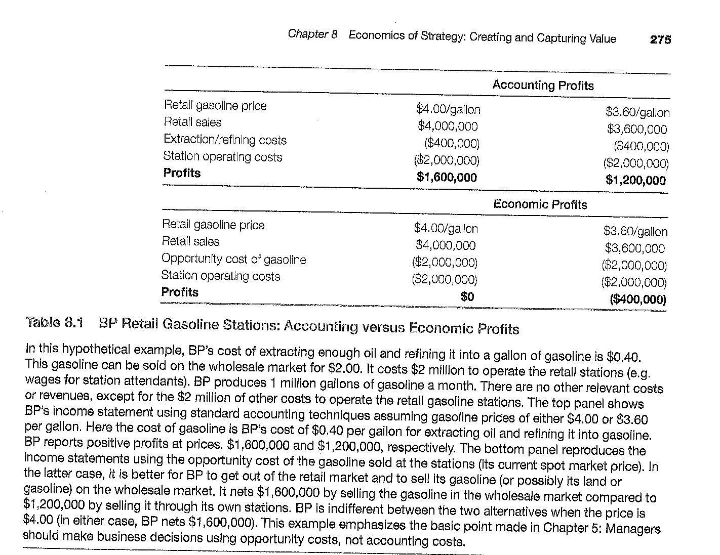
Ramme 271 – 273m.
Se note 21!
Sælge jorden?
Sælge olien?
Raffinér olien?
Producér ikke død og pine selv, bare fordi et aktiv ejes!
Bingo, oder?
De $400.000 (extracting/ refining costs) indgår ikke i beregningen over den økonomiske profit, idet de er sunk og dermed irrelevant for begge scenarier (selv køre ud i detail vs. sælge engros).
Oms. v. videresalg:
1 mio. G * 2$/G.

Slide 12
Regnskabsmæssig/Økonomisk profit, BP-casen supplerende beregning/forklaring
P retail = $4,0 P wholesale = $2,0 | P retail = $3,6 P wholesale = $2,0
∏ retail: $4.000.000 - $ 400.000 (sunk) - $2.000.000 = $1.600.000 (1) | ∏ retail: $3.600.000 - $ 400.000 (sunk) - $2.000.000 = $1.200.000 (3)
∏ wholesale: $2.000.000 - $ 400.000 (sunk) = $1.600.000 (2) | ∏ wholesale: $2.000.000 - $ 400.000 (sunk) = $1.600.000 (4)
Differens-profitten (offeromkostningen-økonomisk profit) ved at sælge retail/på egne stationer i stedet for wholesale: – (2) = 1.600.000 – 1.600.000 = 0 | Differens-profitten (offeromkostningen-økonomisk profit) ved at sælge retail/på egne stationer i stedet for wholesale: (3) – (4) = 1.200.000 – 1.600.000 = - 400.000
Principielt kan de $ 400.000 (extracting/refining costs) helt udelades fra alle beregninger om differens-profit/ offeromkostningen, da disse er at betragte som sunk costs for begge de to scenarier, der sammenlignes og dermed irrelevante…. | …..men de $ 400.000 er selvfølgelig ikke irrelevante vedr. beregningerne over den regnskabsmæssige profit. Bemærk ‘station operating costs’ på $ 2.000.000; er med ved retail men ikke wholesale!

